Slide 1


Proposal for Consulting Services for REC Policy, Regulatory, Stressed Asset and Government Program Support for an initial period of 3 years
REC Limited
August 2021
Private and Confidential

Slide 2
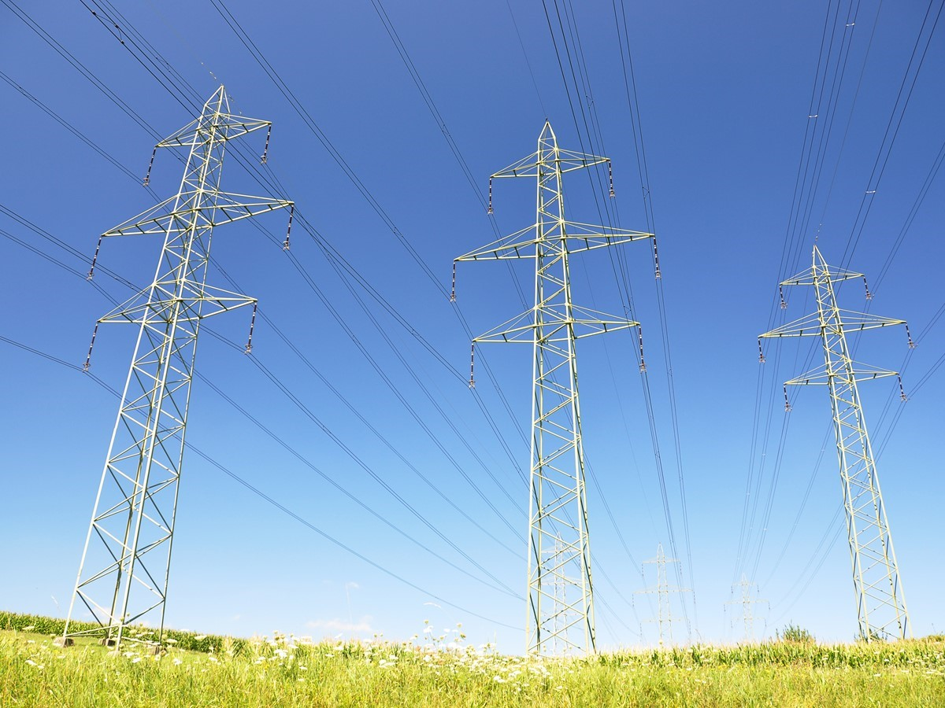
CONTENTS
Our Understanding of the Engagement
Approach & Methodology
Meet the team
About Deloitte
Select Credentials

Slide 3
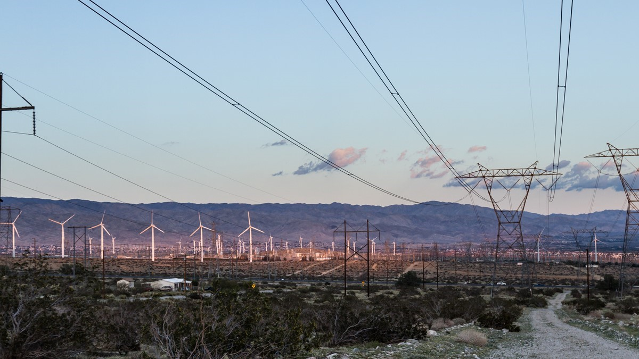
Our Understanding of the Engagement

Slide 4

Changing Industry trends leading to sector evolution
Increasing focus towards technological improvements and modernization of utilities
24x7 power supply, reliable grid
Digitalization of utilities
Network automation & upgradation
Rise of Value-Added Services
Structural Reforms
Privatization for UT Discoms already initiated; state Discoms are next in line
One Nation One Grid
Target of 100% rural electrification
Smart prepaid metering, communicable DT & Feeder Metering with AMI/ NFMS, unified billing software, ERP, Load forecasting etc.
Reduce losses, improve service quality through infra works, Agri-feeder
Consumers are becoming aware and demanding
segregation, SCADA, DMS, OMS, etc.
Business are moving towards service-based models
Financial losses of Discoms have risen 89% y-o-y in FY19
Energy transition and power market reforms to support such transition
Ambitious RE Targets
Falling RE tariffs
Transition towards a centralized power market
Cross convergence of electricity sector with transport sector
Increasing focus on innovative technologies
175 GW by 2022;
450 GW by 2030
Tariffs fell by 85% in last 8 years
Market Based Economic Dispatch
Real Time Market
Ancillary Market
National Green Hydrogen Mission
30% EV by 2030
PLI for battery storage manufacturing
Increasing requirement of peak power due to flexible operation of base load plants
Lowest solar tariff achieved Rs. 1.99 per kWh
Market based approach to bring efficiency in the power market

Slide 5
Engagement drivers
Key engagement drivers
Nodal Agency for GoI Schemes
Growth Areas
Managing Stressed Assets
Revamped Reform based – Results linked Distribution Sector Scheme (Outlay of Rs 3.03 trillion)
Part A – Metering & Distribution infrastructure works (Smart Metering/ Agri feeder segregation, etc.)
Part B – Training, Capacity Building and other enabling & supporting activities
Subsumed past schemes - DDUGJY, SAUBHAGYA, etc.
Counterpart finance of GOI schemes / with Donor funds
Consultancy and value-added services to utilities through subsidiaries
Centralized Technology platforms – NFMS, Centralized Billing Engine, NMS, OMS, etc.
Ownership / Investment in utilities (Privatization/ single source)
Ride the green energy value chain (RE/Hydrogen/ EV/ BESS)
Gross credit impaired assets at 4.84% in FY20-21
Continuance of sub-optimal performance of various state distribution utilities
Deloitte advantage
Leveraging learning from the past (Portfolio advisory and restructuring of infra-assets)
Assist in monitoring of assets
Assist with global and domestic investor connect
Notes:
With multiple new interventions and reform measures being planned, REC wishes to better equip itself to continue shaping up the future of India’s power sector and explore new strategic areas for growth and expansion…

Slide 6
Scope of Engagement
A well conceived scope that identifies high impact areas where Deloitte can add value and support REC in its business endeavors…
01
05
Policy Design & Research Support
Regulatory Research & Monitoring
02
06
Assistance in Management of Stressed Assets
Procurement & Bid Process Management Support
03
07
Strategy Support for Business Expansion
Other Support Areas
04
Program Management & Monitoring of New Govt. Schemes

Slide 7

Our Approach & Methodology

Slide 8
Our Approach & Methodology
Module 1: Policy Design and Research
Approach & Methodology
Deloitte’ sectoral insights to drive policy design
1. Sector Analysis & Research
2. Benchmarking with International policies
3. Assistance in Designing Policies
4. Assistance to REC on decision making
Energy transition labs
Energy transition and decarbonization strategy
Power Market Reforms
Battery Storage, Hydrogen, EVs, Dispatchable RE, etc.
Flexible coal operations
Feasibility studies and program management
Utility modernization
Battery Storage
PP Cost reduction through optimal scheduling and dispatch
Resource adequacy and integrated resource planning
Key outputs
Policy recommendations (Central + State) to improve overall sectoral performance
Periodical generation of reports, analysis on sectoral trends and thought papers
Strategic framework to prioritize policy initiatives
Workshop driven stakeholders’ consultations
Data driven insights generation
Data repository on key performance metrics of the sector

Slide 9
Brief Overview
Stressed power sector assets in India
34 coal-based assets with capacity totaling ~40 GW were under stress, which requires lenders to continuously monitor, identify key issues and carefully analyze the resolution plans
State | Assets | Capacity (MW) | Commissioned (MW) | Debt outstanding (INR Cr) | With PPA (MW) | U/C (MW)
Andhra Pradesh | 2 | 1,920 | 600 | 7,514 | - | 1320
Bihar | 1 | 390 | 390 | 2,181 | 390 | -
CG | 10 | 13,400 | 7,145 | 71,707 | 4,503 | 6,255
Jharkhand | 2 | 1,740 | 540 | 7,027 | 1,489 | 1,200
Madhya Pradesh | 4 | 3,620 | 3,620 | 18,943 | 1,470 | -
Maharashtra | 4 | 6,570 | 5,250 | 24,805 | 3,900 | 1320
Odisha | 6 | 6,370 | 2,589 | 29,504 | 2,722 | 3,781
Punjab | 1 | 540 | 540 | 4,346 | 540 | -
Tamil Nadu | 1 | 1,200 | 1,200 | 6,483 | 558 | -
UP | 2 | 3,180 | 3,180 | 13,540 | 2,782 | -
West Bengal | 1 | 1,200 | 1,200 | 1,724 | 654 | -
Total | 34 | 40,130 | 26,254 | 187,774 | 19,008 | 13,876
Few Key Issues in Power Sector
Delay in commissioning of projects causing time and cost over run
Inability of the promoter to infuse equity
Inadequate supply of coal under FSA leading to procurement of high-cost coal from e-auction and open market resulting in increased cost of generation
Delay in receipt of dues from DISCOMs
Delay in recovery of proceeds attributable to change in law events
Working capital issues
Locational challenges – floods causing operational inefficiencies, local disturbance – R&R issues, etc.
Out of the 34 stressed power sector assets –
~~ 16 - 19 GW* of capacity have been resolved / standard
~ 12 - 16 GW are under various stages of resolution
~ 7 – 8 GW of capacity may undergo liquidation process
Source – Ministry of Power report and secondary research
* Few of the resolved projects require further deliberations based on performance.

Slide 10
Brief Overview
Stressed Asset Space in India
Total stressed assets & contribution by power sector
Total stressed assets (NPAs) in India rose to more than INR 10,00,000 crore as on March 2018. This amount reduced to ~ INR 8,00,000 in September 2020
Stress attributable by power sector comprises of ~ 24% of the total portfolio of stressed assets in the country
Resolution Mechanism being followed for stressed assets
Resolution mechanism for projects already resolved mostly include resolution by way of IBC / restructuring / change in ownership outside IBC
Deloitte provided professional advisory services to Resolution Professional of Korba West Power Company Limited during CIR process - power asset resolved through IBC route
~ 75% of the total projects which are likely to be resolved are currently under various stages of NCLT. Apart from these projects, ~14% have been referred to NCLT
Why Deloitte and Why this team ?
50+ successful M&A transactions in last 5 years (Agg. value – over USD 20 Bn). Illustrative list of key power sector credentials by Deloitte include –
Deloitte provided professional advisory services to RP during CIRP of Korba West (Taken over by Adani Power for INR 2,700 crore)
Portfolio advisory services on resolution of stressed assets to Power Finance Corporation (PFC)
Assisted PFC in acquisition of 52.63% stake in REC Ltd held by Government of India for INR 14,500 crore.
Process advisor to CoC of Jal Power Corp
Assisted DIPAM in strategic sale of GoI's existing total paid up equity shareholding i.e., c. 74.49% in THDC India Limited to NTPC Limited
Deloitte provided professional advisory services to RP during CIRP of a few other power assets like Simhapuri, Corporate Power, Ind-Barath Gencom, Maa Durga
Further, Deloitte is assisting in restructuring of a few projects under RBI June 07 circular
Providing professional advisory services to resolution professional of a stressed transmission sector asset
Deal team has an extensive experience of working in power sector space in the current and previous employment

Slide 11
Our Approach & Methodology
Module 2: Assistance in Management of stressed assets
Indicative Support Areas
As on March 31, 2021 , total loan portfolio of REC is INR 377,418 crore
Sector wise distribution of Stage III – Credit Impaired Assets (NPAs) of REC is mentioned hereunder.
Identification of key parameters causing stress in Indian power sector
Categorization of REC’s loan portfolio in power generation and transmission on the basis of key issues identified
Propose a targeted and custom approach for each category of assets, based on the timing of resolution
Analyse various resolution plans submitted by borrower and recommend suitability of the plan from REC’s perspective
Participate in lenders meetings (wherever relevant and as advised by REC), until such time as a preferable resolution option has been identified
Assist REC in meetings with stakeholders (MoP, RBI, Central & State Utilities) in connection with the Resolution Plan
Assist REC in preparation of replies to various questionnaire/ queries in relation to stressed projects
Support, to the extent possible, REC team in IBC proceedings
INR Crore
State | O/s Loan | ECL | Provision Coverage Ratio (%)
Gencos. | 17,277 | 11,307 | 65.45%
Transcos. | 922 | 461 | 50.00%
Renewables | 58 | 23 | 39.66%
Total Private Sector | 18,257 | 11,791 | 64.59%
These stressed assets require lenders to continuously monitor, identify key issues and carefully analyze the resolution plans.
Deloitte shall provide end-to-end support to REC leveraging our similar portfolio advisory experience

Slide 12
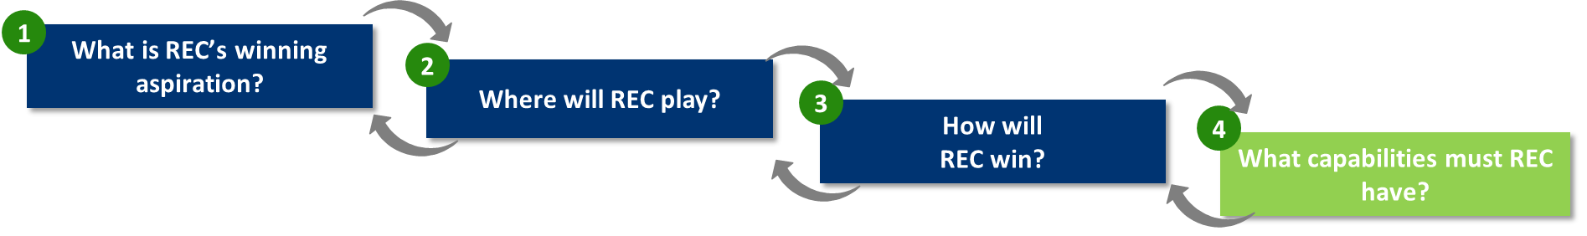
Our Approach & Methodology
Module 3: Strategy Support for business expansion
Deloitte will use its proprietary “Play to Win“ framework to provide strategy support to REC on business expansion
Strategic Choices
Key Questions
ILLUSTRATIVE
Industry Focus
How is the power sector & allied industries likely to evolve in the next 5-10 years? How prepared is REC to leverage these changes?
How can REC best leverage its existing assets / capabilities to generate additional revenue, while not losing out in its core market?
What are the most attractive “where to play” choices (value chain, geographies, industries) for REC?
Which ones are the most attractive?
Which ones should REC target?
What assets / capabilities does REC need to develop / acquire?
Increase share in extended capabilities by Consortium Participation/ Collaborations
Expand Extended Capabilities to Other Geographies
Geographic Spread
Value Chain Presence
Expand Industry Play in Extended Capability/ Product Set
Offer New Capabilities/ Products for Core Industries
Revenue
Increase share by Consortium Participation/ Collaborations
Expand Current Capabilities to Other Geographies (SEA, SA)
Expand Current Capabilities to Allied Industries (Equipment, Storage, EVs, Smart Cities)
INR 29855 Crore (FY20)
Increased share in Nodal Agency / non-compete business segments
¹ 1 USD = 65 INR
REC’s Business Today
Growth by Leveraging Current Capabilities
Growth by Developing New Capabilities

Slide 13
Our Approach & Methodology
Module 3: Strategy Support for business expansion
Illustrative Additional/ Incremental Ideas
REC VOICE Initiative
(Voice of India Consumers of Electricity)
REC National Electricity App
(Integrated Platform Play)
Lending + Reforms Support to States
District Level Customer Feedback on Reliability, Quality, Infrastructure and Services
Direct consumer surveys + Digital means of gathering insights
Propagate end use by Regulators/ FOR, State Governments, Utilities and Policy Makers
Self-sustaining business model
Customer Feedback essential in monopolized set-up
Free National App for Billing, Payments, Complaints tracking etc.
Facilitate DBT in electricity
Platform to enable ecosystem for Electricity/ Electrical Market place – (for equipment, prosumers, energy efficiency)
25 Cr. user base can create huge value for the App as a market place
Support reforms in addition to lending infrastructure creation
MOU for transformation, driving profitability, Governance;
Potential Equity holding in State Utilities
Support in listing readiness as an alternative to privatization
REC could play increased role in reforms process, akin to MDBs
Illustrative Ideas
Illustrative Ideas

Slide 14


Our Approach & Methodology
Module 4: Support in program management and monitoring of New Govt. schemes
CPMU Project Governance Structure
Prepare scheme functional documents (SBDs, DPRs, Grant/Loan approval)
Engagement Partner
Central PMU Cell
Progress monitoring framework (identify slippages, issues, tracking)
Subject Matter Experts
Think Tank
Monthly Project progress review meeting
Project Governance and Monitoring
Project Execution & Support
Risk management and governance (risk identification & mitigation)
Support to REC in all modules
Led by Engagement Manager
Support to REC on key strategic areas
MIS & Analytics (Inputs for MIS framework and web portal)
Continuous field support
REC counterpart team
Setting up of CPMU Cell
Finalizing data & information collection plan
Setting up Review & Monitoring Mechanism
Developing a ‘Risk Management’ framework
Deployment of Analytics

Slide 15


Our Approach & Methodology
Module 4: Support in program management and monitoring of New Govt. schemes
CPMU Project Governance Structure
Prepare reports and documents as per guidelines issued by MoP/Nodal Agency
Engagement Partner
Progress monitoring framework (identify slippages, issues, tracking)
Subject Matter Experts
Think Tank
Monthly Project progress review meeting
Project Governance and Monitoring
Project Execution & Support
Risk management and governance (risk identification & mitigation)
Support to REC in all modules
Led by Engagement Manager
Support to REC on key strategic areas
MIS & Analytics (Inputs for MIS framework and project management tool)
Continuous field support
REC counterpart team
Setting up of AMI-PMA Cell
Finalizing data & information collection plan
Setting up Review & Monitoring Mechanism
Identification and mitigation of risks
Deployment of Project Management Tool

Slide 16
Our Approach & Methodology
Module 5: Regulatory Research and Monitoring
Regulations tracking (Existing / upcoming)
CERC / FOR - Power Markets, 2021, Sharing of ISTS Charges & Losses, Real Time Market, Model regulations for Distributed Energy Resources
SERCs - Discussion Papers, Open Access, Charging stations for EVs, Forecasting, scheduling & Deviation Settlement of RE
01
Monitoring Tariff reforms
Timely filling of tariff petitions/ MYT and issuance of Tariff Orders and annual tariff fixation, and rationalization of consumer categories
Compliance to directives issued by Regulatory Commissions
02
Policy perspective and business implication
Action plan for reducing ACS-ARR gap, subsidy analysis and its delivery through DBT, loss reduction, and increased focus on energy audit
Review of metering implementation models such as TOTEX, CAPEX, OPEX, etc. and evaluate their business impact
03

Slide 17
Our Approach & Methodology
Module 6: Procurement and bid process management support
Increased role as Nodal Agency in programs such as National Feeder Monitoring System, Revamped Distribution Sector Scheme, Standardized back-end IT applications, VOICE (Voice of Indian Consumers of Electricity) Initiative etc. would require differentiated and agile procurement process and workflows, including creation of:
Policies & Procedures (compliant with REC Procurement Guidelines, CVC guidelines, Delegation of Power, etc.)
Vendor empanelment process
Standard Bidding Documents, where necessary
Technology platform (incl. data analytics)
Benchmarking best practices (domestic and international)
Recommendation on To-Be Stage
Support during Bid Process Management
Requirement gathering and market sounding
Prepare pre-qualification document
Prepare & float final bid document
Conduct pre-bid meeting and make necessary changes
Bid Evaluation
Selection of bidders & contracting
Vendor onboarding & Work commencement

Slide 18
Our Approach & Methodology
Module 7: Support in other areas
Assist in analysis and presentation on need basis to various stakeholders (MoP, Borrowers, lenders etc.)
Need based Analysis and Presentation
Assist in facilitating capability building workshops/trainings for various stakeholders linked to policy making, project management, etc. in the power sector
Facilitate in arranging various consultation workshop, conferences, webinar etc. to drive market opportunities
Capability Development
Stakeholder Consultation
Global Best Practices
Develop a report on global best practices in the power sector pertaining to financing, schemes for sector reforms, etc.

Slide 19

Meet the Team

Slide 20
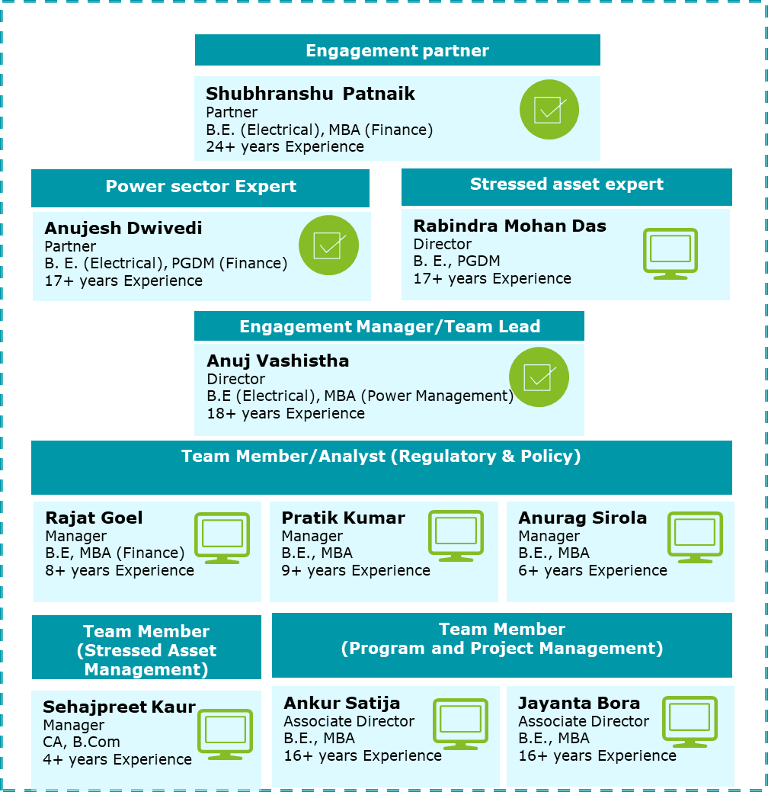
Our team to serve you
Individually and collectively, our team has the experience needed to deliver results in your business environment. The people in our team have led complex engagements and served major clients in your industry on similar engagements.
ROLE
RESPONSIBILITIES
Manage relationship with your management.
Make key decisions, sign-off on major deliverables and has overall project responsibility.
Provide final review of engagement deliverables.
Our experts bring in leading insights on Power Sector and Stressed Asset matters.
Provide necessary guidance and oversight to the project team.
Review all the documents and recommendations provided to REC.
Part of the Steering Committee and shall join review meeting with the REC leadership.
Interact and coordinate with the Senior Management, key stakeholders of REC.
Ensure project objectives are met within timelines and scope outlined.
Provide progress update to stakeholders.
Manage resources deployment and deliverable review.
Conduct all assigned tasks in the project.
Interface with client personnel on-site.
Draft required deliverables.
Support in Regulatory & Policy related matters.
Support on areas of stressed asset management.
Support in Project and Project Management.

Slide 21
Deloitte refers to one or more of Deloitte Touche Tohmatsu Limited, a UK private company limited by guarantee (“DTTL”), its network of member firms, and their related entities. DTTL and each of its member firms are legally separate and independent entities. DTTL (also referred to as “Deloitte Global”) does not provide services to clients. Please see www.deloitte.com/about for a more detailed description of DTTL and its member firms.
This material has been prepared by Deloitte Touche Tohmatsu India LLP (“DTTI LLP”), a member of Deloitte Touche Tohmatsu Limited, on a specific request from you and contains proprietary and confidential information. This material may contain information sourced from publicly available information or other third party sources. DTTI LLP does not independently verify any such sources and is not responsible for any loss whatsoever caused due to reliance placed on information sourced from such sources. The information contained in this material is intended solely for you. Any disclosure, copying or further distribution of this material or its contents is strictly prohibited.
Nothing in this material creates any contractual relationship between DTTI LLP and you. Any mutually binding legal obligations or rights may only be created between you and DTTI LLP upon execution of a legally binding contract. By using this material and any information contained in it, the user accepts this entire notice and terms of use.
©2021 Deloitte Touche Tohmatsu India LLP. Member of Deloitte Touche Tohmatsu Limited

Slide 22

About Deloitte

Slide 23

About Deloitte
Deloitte is one of the world’s largest and most diversified professional services organisations, providing assurance & advisory, tax, management consulting, and enterprise risk management services through more than 334,800 professionals in more than 150 countries. Our organisation includes a unique portfolio of competencies integrated in one industry-leading organisation. Deloitte Touche Tohmatsu India LLP (DTTI LLP) is a member firm in India that provides non-audit consulting services. Our experienced professionals deliver seamless, consistent services wherever our clients operate.
REVENUE
US$47.6B
HEADCOUNT
334,800
COUNTRIES AND TERRITORIES
150+
DELOITTE FY2020
OFFICES
674
SOCIETAL IMPACT CONTRIBUTIONS
US$265M+
DELOITTE PROFESSIONALS WHO EXPERIENCED DELOITTE UNIVERSITY
114,000+
NEW HIRES
88,820
Deloitte member firms serve 82% of the 2020 Fortune 500 companies

Slide 24
Industry recognitions
Deloitte has been positioned highest in the ability to execute in Software Asset Management Managed Services Magic Quadrant by Gartner in 2020.
Deloitte was named a leader in Procurement Operations Consulting by ALM Intelligence in their report Procurement Operations Consulting Vanguard 2020.
Deloitte has been recognized as a leader in The Forrester Wave for Enterprise Insight Service Providers in Q2, 2020.
Deloitte has received the highest score in Assessment and Strategy Use Case in Gartner’s Critical Capabilities for Oracle Cloud Applications Services.
Deloitte receives high scores in Critical Capabilities for Public Cloud Infrastructure Managed and Professional Services by Gartner.
Deloitte named a global leader in Public Cloud Infrastructure Managed and Professional Services by Gartner.
Deloitte named a global leader in Oracle Cloud Applications Services by Gartner.
Deloitte has been named a Leader in Gartner’s 2020 Magic Quadrant for SAP S/4HANA Application Services, Worldwide
Deloitte named a Leader in the 2020 Magic Quadrant for CRM and Customer Experience Implementation Services by Gartner.
Deloitte named a leader for the 6th consecutive time in Data and Analytics Service Providers, Worldwide by Gartner.
Deloitte named a global leader in Sourcing Strategy Consulting by ALM Intelligence.

Slide 25
Presence in India
Deloitte India is one of the leading professional services firms with a rich heritage of serving the best-in-class clients in India
India clientele (November 2020 BT500*)
New Delhi
12000+
Jamshedpur
Serves
Serves
Ahmedabad
115
148
Kolkata
Professionals
spread across
Consumer
of
Energy resources & Industrials
of
Mumbai
Hyderabad
137
173
Pune
companies
companies
Goa
4
4
Bengaluru
Serves
Serves
75
38
Chennai
12
Financial services
of
Life sciences & healthcare
of
Kochi
Coimbatore
88
48
companies
companies
4
4
Services in India
Assurance
Tax
Financial Advisory
Risk Advisory
Consulting
Serves
Serves
Cities
43
7
Tech, media & telecom
of
Government Public sector
of
46
8
companies
companies
*BT500 - Business Today publication about India’s top 500 performing companies

Slide 26
Multidisciplinary capabilities in India- Integrating a global spectrum of capabilities
Professional staff : In India, Deloitte is recognised as one of the country’s top professional services firms, with over 11,500+ professional staff. Our professionals are proficient at delivering the right combination of local insight and international expertise to our clientele drawn from across industry segments.
Our services : Deloitte is well-equipped to deliver solutions to the complex challenges faced by organisations across the public and private sectors. Being one of the largest professional services organisations, our edge lies in our ability to draw upon a well-equipped global network and teaming this with customised services at a local office.
SERVICES IN INDIA
Consulting
Assurance
Tax
Financial Advisory
Risk Advisory
Strategy, Analytics and M&A
Digital Customer & Marketing
Core Business Operations
Human Capital
Enterprise, Technology & Performance
A Comprehensive Audit Process
Assurance Services
Specialised Audit Services Including Detailed Investigations
Business Process Solutions
Global Business Tax
Global Employer Services
Indirect Tax
Mergers and Acquisitions (M&A) – Tax
Tax Analytics
Transfer Pricing
Corporate Finance & Restructuring
Forensic
M&A Transaction Services
Valuation & Modelling
Accounting & Internal Controls
Cyber & Strategic Risk
Regulatory & Legal Support
Deloitte is well-equipped to deliver solutions to the complex challenges faced by organisations across the public and private sectors. Being one of the largest organisations, our edge lies in our ability to draw upon a well-equipped globally customised services at a local office.
Note: All of the services listed here may not be available from every Deloitte member firm. In addition, there may be local regulations restricting the provision of certain services to attest clients

Slide 27

Energy and resources Global Practice by the Numbers
Power Utilities Global Practice by the Numbers
A leader in power and utilities
92%
We serve 92% of the Fortune 1000 power and utilities companies
Deloitte member firms serve 73% (or 69 companies) of the 95 Fortune Global 500® E&R companies
1,000+ practitioners with deep experience in power and utilities
A leading voice in risk, financial, and IA services
Worldwide leader in risk advisory consulting services based on capability and strategy
of the 17 largest Mining companies
of the 26
largest Power
companies
of the
Water companies
10
21
All
400 internal audit clients in the United States and >1,000 globally
of the 49
largest
Oil & Gas companies
35
of the largest Shipping & Ports
companies
All
Transforming through innovation
Several hundred million dollars invested in next-generation technologies
Delivered hours of Internal Audit Analytics

Slide 28

Select Credentials

Slide 29
Our selected credentials
Category A: Experience in project management, program management, setting up a PMU for power distribution business for power distribution utilities in India
Project Management agency for implementation of DDUGJY and IPDS for DISCOMs in Rajasthan
Strategic Central Project Management Unit to Evaluate and Monitor Project Implementation
Urja Mitra Program Monitoring, Diagnostic analysis of Revenue Cycle, and Monitoring of MBC
Setting up of PMU for Development of Power Market in India
Program Management Support to CERC, POSOCO for pilot implementation under GTG-RISE initiative
Battery Storage Program Assessment for Selected States
Sector reform and utility Commercialization (SRUC) to promote reforms that will enhance the financial viability
JVVNL, JdVVNL & AVVNL
JBVNL
JBVNL
MoP / NEARS
USAID/ MOP/ CERC/ POSOCO
World Bank/ Niti Aayog
USAID
Consultancy services in various programs of MPUVN and RUMSL in areas including RE and associated emerging fields
Project management Consultancy for smart metering projects
Project Management services to RECPDCL for Smart Metering
PMA for Computerization of commercial processes
Preparation of DPR for floating solar and ground mounted Solar park in MP
Support for Smart meter project component preparation and SCADA DPR preparation
RUMSL & MPUVN
JBVNL
RECPDCL
UPCL
MP
KFW/ MPPMCL

Slide 30
Our selected credentials
Category B: Experience in supporting on areas of stressed asset management including areas of valuation, commercial and technical due-diligence, Resolution Professional (1/2)
Commercial & Regulatory due diligence-275 MW solar park in Odisha
Transaction and bid advisory support to Solenergi for 750 MW REWA Ultra mega solar project bid process
Commercial Due Diligence of SB Energy
Commercial due diligence of Essel Infra Solar
Consultancy services in various programs of MPUVN and RUMSL in areas including RE and associated emerging fields
Transaction Advisory Services for development of 600 MW floating solar park at Omkareshwar in the state of MP
Transaction advisory services for selection of investor for sale of NESCO Utility
IFC, the World Bank Group
REWA Ultra mega solar project
Actics GP LLP
Actics GP LLP
RUMSL & MPUVN
RUMSL
OERC
Transaction advisory services for selection of investor for sale of SouthCo Utility
Transaction Advisory service for hiving off existing RE business into a Wholly Owned Subsidiary
Buy side advisory to PFC for acquisition of 52.63% equity stake held by GoI in REC Limited
Sell side advisory to DIPAM for sale of c. 74.5% equity stake held by GoI in THDC India Limited to NTPC Limited
Advisory to Committee of Creditors (CoC) of Jal Power for evaluation of resolution plans
Professional advisory services to the Resolution Professional of Korba West Power Company Ltd. Incl. sell-side financial advice
Professional advisory services to the Resolution Professional of Lanco Infratech Ltd. Incl. sell-side financial advice
OERC
NTPC
Power Finance Corporation Limited (PFC)
Department of Investment and Public Asset Management
CoC of Jal Power
RP of Korba West Power Company
RP of Lanco Infratech Limited

Slide 31
Our selected credentials
Category B: Experience in supporting on areas of stressed asset management including areas of valuation, commercial and technical due-diligence, Resolution Professional (2/2)
Professional advisory services to the Resolution Professional of Lanco Kondapalli Power Ltd. Incl. sell-side financial advice
Professional advisory services to the Resolution Professional of Simhapuri Energy Limited undergoing CIR process
Professional advisory services to the Resolution Professional of South East U.P. Power Transmission Company Ltd.
Professional advisory services to the Liquidator of Lanco Infratech Limited undergoing liquidation process
RP of Lanco Kondapalli Limited
RP of Simhapuri Energy Limited
RP of Southeast U.P. Power Transmission
Liquidator of Lanco Infratech Limited

Slide 32
Our selected credentials
Category C: Experience in providing regulatory related work in distribution, transmission and generation sector for Power utilities, Regulatory commissions, MoP and Forum of Regulators (1/2)
Consultancy services for providing assistance to in all regulatory areas on retainership basis
Engagement of Regulatory Affairs Consultant under WBSETCL
Regulatory support to JUSCO for MYT, True Up and APR
Consultancy Services for Regulatory Requirement of JUSCO
Regulatory support in filing for True up for FY20, APR for FY21, MYT for FY22-26 and miscellaneous petition with JSERC
Regulatory support in True Up order review (2015-16) & MYT petition submission to JSERC (incl three amendments)
Technical Assistance for Power Sector Development of South Asian Countries
WBSEDCL
WBSETCL
JUSCO
JUSCO
Inland Power
Inland Power
US Department of States
Regulatory assistance in review of petitions and preparation of tariff orders for the G-T-D utilities, SLDC for a period of 5 years (3rd Control Period)
Regulatory assistance in review of petitions and preparation of tariff orders for the G-T-D utilities, SLDC for a period of 5 years (4th Control Period)
USAID Assignment - Regulatory Support to CERC, FOR, POSOCO under GTG-RISE initiative
Evolving Principles of Depreciation for Distribution Assets and Operating and Financial norms for Distribution Sector
Study on “Review of Status of Open Access in Distribution”
Study on "Consumer Protection in electricity sector of India "
Regulatory Support on retainership basis for MYT petition for the Control Period FY 2016-17 to FY 2020-21
HPERC
HPERC
CERC, FOR, POSOCO
Forum of Regulators (FOR)
Forum of Regulators (FOR)
Forum of Regulators (FOR)
JBVNL

Slide 33
Our selected credentials
Category C: Experience in providing regulatory related work in distribution, transmission and generation sector for Power utilities, Regulatory commissions, MoP and Forum of Regulators (2/2)
Preparation of capital investment plan and ARR for the control period of 2019-22 tariff petitions for the FYs 2019-20, 2020-2021 and 2021-2022
Consultancy services on retainership basis for preparation of transmission, generation and distribution tariff and ARR filing for DVC
Regulatory Assistance in True-up, APR, Annual Revenue requirement and determination of Tariff Petition for FY2018-19
Regulatory assistance to Deendayal Port Trust in filing tariff petition for True up of for FY19, FY20, and determination of ARR for FY22 before GERC
Support to revise old regulations and frame new regulations
APGCL
DVC
JERC
PTC India
OERC
Consultancy Support for regulatory affairs and tariff determination of MSPCL
Regulatory assistance in preparation of Business Plan and MYT Petition for the Control Period FY22 to FY26
Regulatory support for preparation of Financial Model for FGD and support at PSERC
Preparation of Business plan and MYT petition for control period for FY20 to FY22
Regulatory assistance in preparation of ARR and Tariff Petition of UPCL for FY2018-19
MSPCL
TVNL
Talwandi Sabo
UPCL
UPCL

Slide 34
Opportunities in emerging areas
Asset Heavy Models
Asset Light Models
Loss reduction and efficiency improvement support to Discoms
Privatization, DFs to improve supply reliability
Emerging Opportunities for REC
Assist utilities in developing and managing smart grid elements
Behind the meter services (smart home management)
Assist consumers with energy conservation, analytics
Feeder Monitoring and unified billing system
EV Charging and Battery swapping
Energy Storage Technologies
Back

